Slide 1

Research Question –
Is there a difference in the mean of minute (goal timing) between own goals and regular goals?
Date: 11/12/2025
Group Name: A 102 Name of Student Presenting: PAVAN KUMAR MUKKALA

Slide 2
This dataset is interesting to us because it provides detailed goal-scoring data from women's international football matches from 1984 to 2025, allowing us to analyze timing patterns, own-goal occurrences, and trends over time to inform strategies in women's sports analytics.
Our Independent variable is: Own Goal Status (TRUE/FALSE)This Independent variable datatype is: Nominal/Categorical Our Dependent variable is: Minute of Goal This Dependent variable datatype is: Interval/Measurement Data
Dataset ID: Female Footballers Dataset (ds260)
Notes:
Before specifying your Research Question you must define the type of data you are analysing. Are the variables you select interval data (measurement data you can divide, multiple, etc), OR are they ordinal (there is a definite order but the intervals between each variable are not necessarily equal, or the terms might be subjective like in a likert scale); OR are they just categorical/nominal (Items such as film names, cities, etc., that you can count numbers of occurrences? You also need to understand whether the variable is either dependent or independent and this will vary according to the context. Independent variables may cause an effect, whereas the dependent variable might be effected by the independent variable. Check the lecture notes on the RQ for more information and examples.
You will get only one opportunity to present your Research Question ahead of the submission date. Have your questions ready, and be ready to take notes on feedback.

Slide 3
“Is the average minute at which own goals are scored different from the average minute at which regular goals are scored in women's international football matches?
”Null Hypothesis (H₀): The average minute at which own goals are scored is equal to the average minute at which regular goals are scored in women's international football matches. Alternative Hypothesis (H₁): The average minute at which own goals are scored is not equal to the average minute at which regular goals are scored in women's international football matches.
Our Research Question is

Slide 4
Sanmiguel-Codina et al. (2025): Analyzed 95 goals in UEFA Women's EURO 2022, finding assists from lateral corridors and shots from central zones, many aerial and first-touch; highlighted second-half goals but limited focus on own goals as errors.
Martínez-Hernández et al. (2024): Examined movements in Women's Super League, identifying linear motions as predominant before goals, with role-specific differences in intensities; emphasized high-intensity actions and potential late-match defensive errors.
Mesquita et al. (2023): Analyzed 174 goals from elite teams, revealing most from organized attacks and set pieces, with mid-match peaks; called for deeper temporal analysis of errors like own goals in women's football.
Background Research

Slide 5
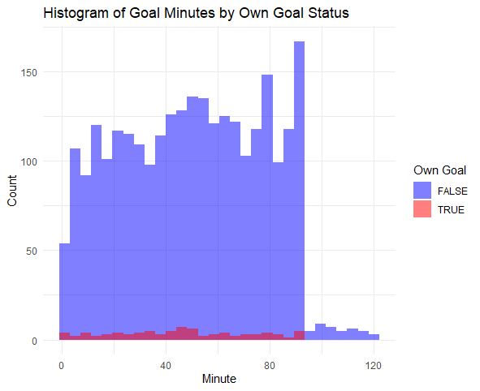
Histogram showing Goal minutes by Own Goal status
Visualizations

Slide 6
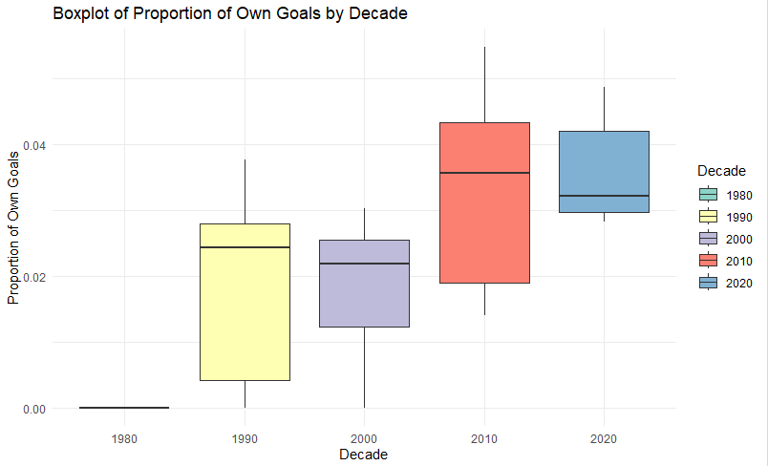
Boxplot of Proportion of Own Goals by Decade
Visualizations

Slide 7
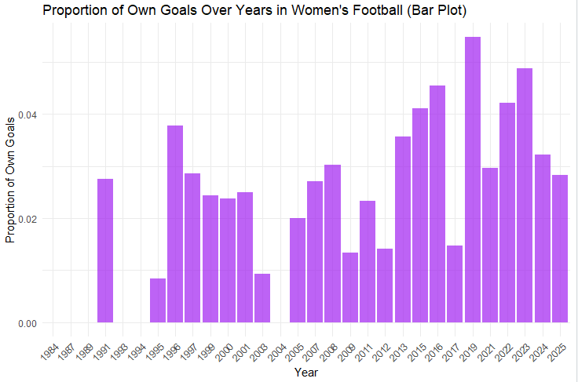
Analysis and Results
Wilcoxon rank-sum test (non-parametric due to non-normality): W = 120785, p-value = 0.1845 (>0.05). Fail to reject H0 – no significant difference in averages (regular: 49.86, own: 45.79).
Additional: Own goals 2.93% overall; slight increase over years; similar home/away.

Slide 8
https://github.com/vishalmadhira24/7COM1079-0901-2025-Project
Github Link

